Slide 1
Manufacturing Analytics
Group No : 3
Team Members
1) Akanksha Kadam
2) Bhanukiran kudikyala
3) Ganesh Gorule
4) Shrikant sahu
5) Soham Kulkarni
6) Radhika Pawar
7) Sidharth P S

Slide 2

Introduction
Manufacturing Analysis is a project focused on examining production data to understand efficiency, quality, and overall performance in the manufacturing process. It helps identify trends, highlight issues like wastage or rejection, and improve decision-making by using KPIs and visual dashboards.
The goal of the project is to optimize operations and enhance productivity
This Photo by Unknown Author is licensed under CC BY-SA

Slide 3
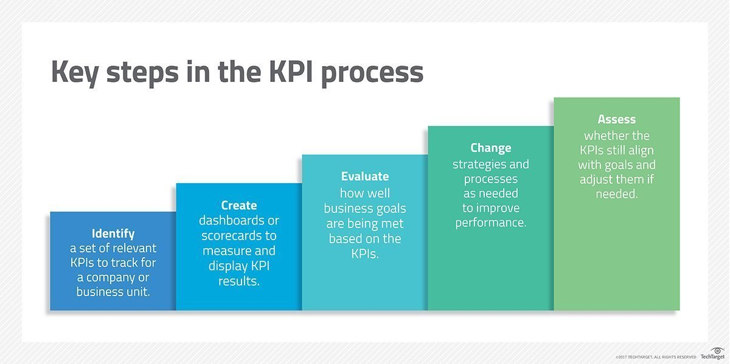
KPI’s
1. Wastage % (0.82%)
2. Rejection % (0.99%)
3. Processed Quantity (60M)
4. Manufactured Quantity (50M)
On –Time Delivery (33%)

Slide 4

Insights
1. Manufacturing Quality is Good
➡ This indicates strong process control and good manufacturing practices.
2. Buyer-wise Production is Balanced
➡ No buyer is overly dominant; production is evenly distributed.
3. Woven Labels Department Has the Highest Output
➡ Indicates high demand or capacity in this department.
4. Printed Fabric Department Needs Improvement
➡ Suggests quality issues or machine inefficiencies.
5. Monthly Production Shows Fluctuations
➡ Indicates seasonality in orders, requiring workload balancing and labor planning.

Slide 5
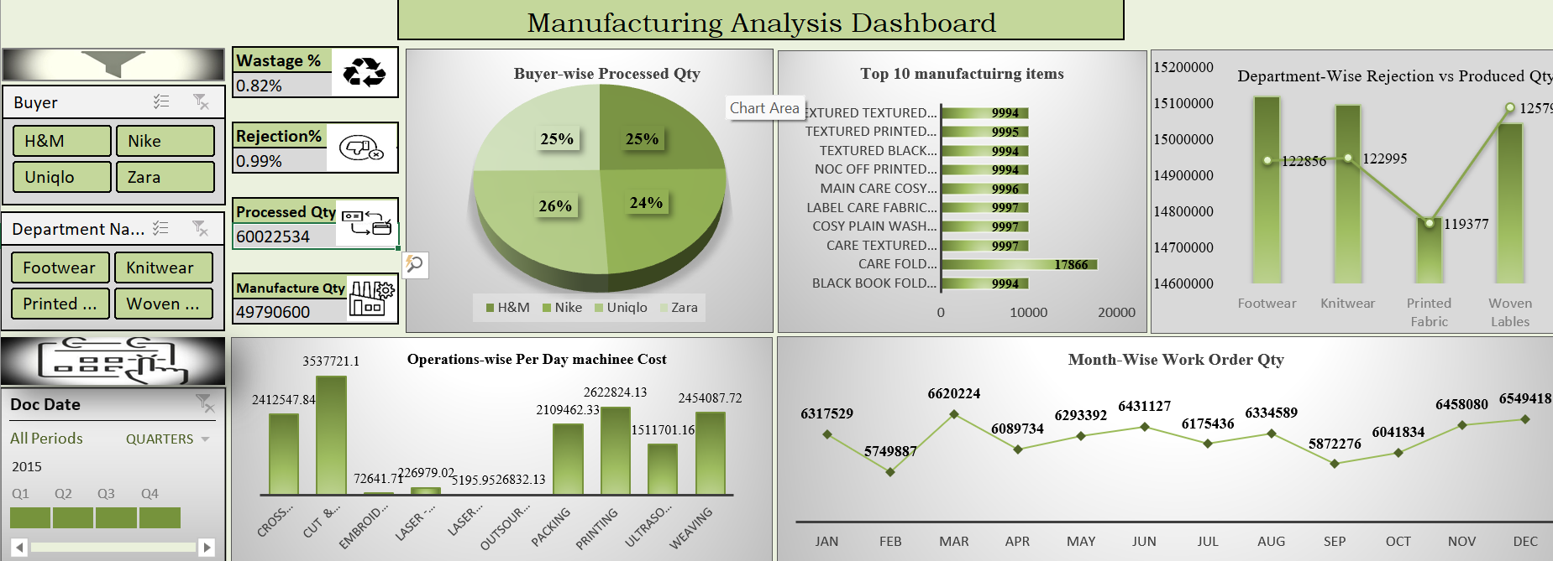
Excel Dashboard

Slide 6
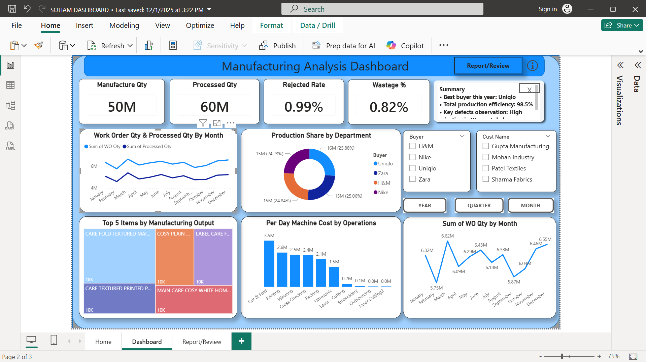
Power Bi Dashboard

Slide 7
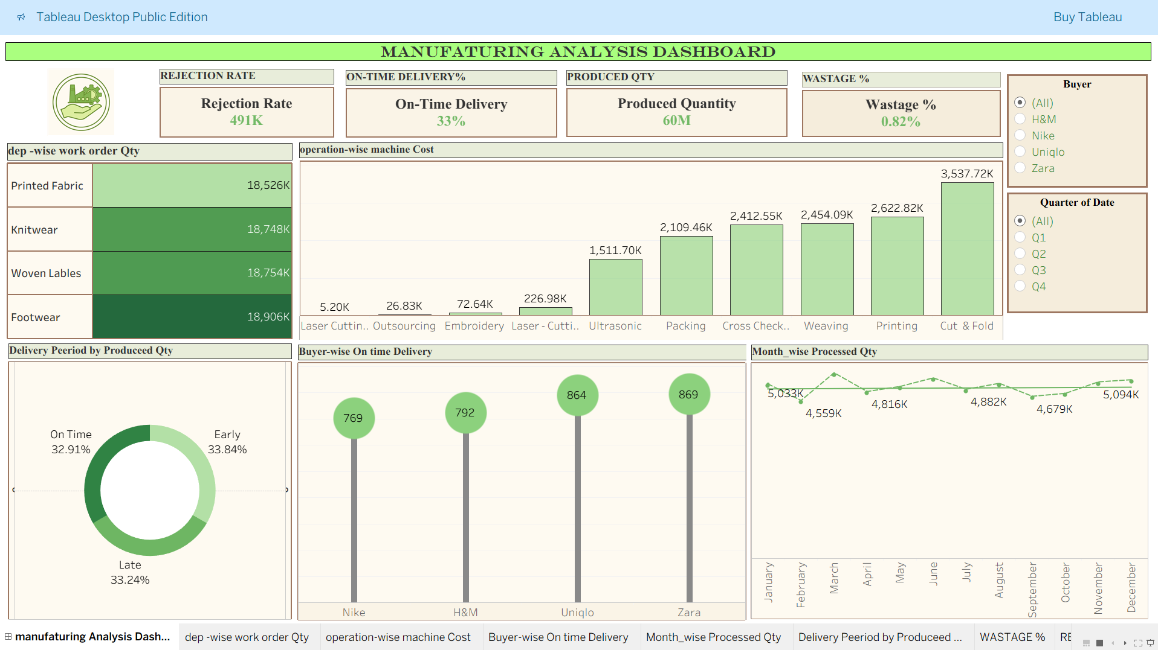
Tableau Dashboard

Slide 8
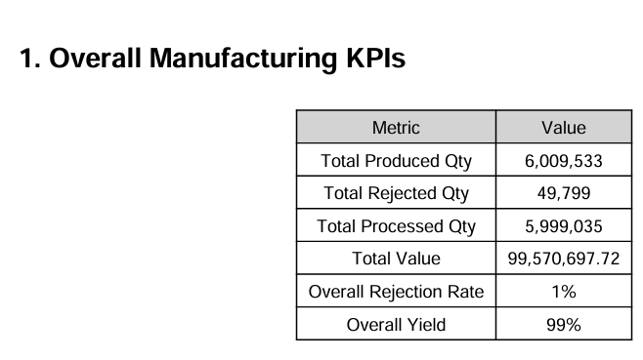
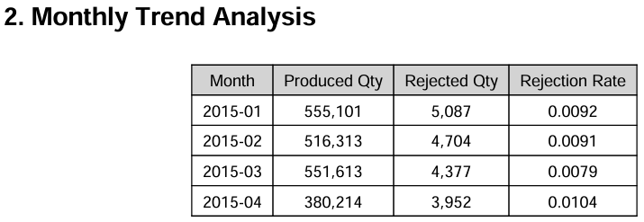
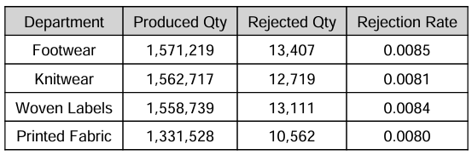
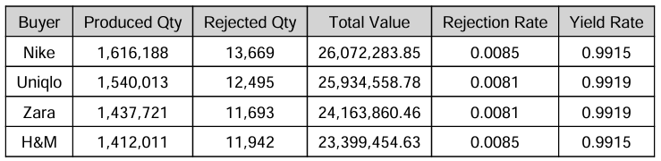
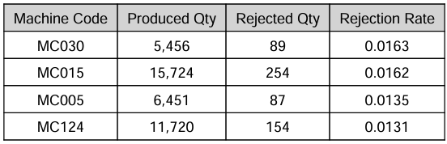
SQL Queries Outputs
Overall Manufacturing KPIs
2. Monthly Trend Analysis
3. Dept-wise Performance
4. Buyer-wise Manufacturing KPIs
5. Machine-wise Rejection Analysis

Slide 9
Project Summary
The project tracks total manufacturing quantity (49,790,600 units) and processed quantity (49,299,577 units) with very low wastage (0.82%) and rejection rates (0.99%).
2. Buyer & Department Analysis: Production is analyzed buyer-wise (H&M, Nike, Uniqlo, Zara) and department-wise (Footwear, Knitwear, Printed Fabric, Woven Labels), highlighting contributions and rejection trends.
3. Top Products: The top 10 manufactured items are identified, allowing focus on high-volume products and efficiency optimization.
4. Cost & Operations Tracking: Daily machine-wise operation costs are monitored across all processes (Cut, Embroidery, Laser, Outsourcing, Packing, Printing, Weaving) for better cost management.
5. Trend Analysis: Monthly work order quantities and department-wise production vs. rejection trends are analyzed to identify bottlenecks, production fluctuations, and areas for improvement.

Slide 10


